Slide 1



AWS Rekognition

Slide 2

01
Objective
03
Cloud Features
Architecture
04
Architecture diagram
02
Objective of the case study
Cloud features used in the case study
Architecture of the system
Mapping of cloud Models used in the case study

Slide 3


What is AWS Rekognition?
Rekognition is a AWS service that provides deep learning visual analysis for your images. Rekognition is very easy to integrate into your application by providing an image or video to the AWS Rekognition API. The service will identify some following: objects, people, text, scenes, and activities. "Amazon Rekognition also provides highly accurate facial analysis and facial recognition. You can detect, analyze, and compare faces for a wide variety of use cases, including user verification, cataloging, people counting, and public safety.“

Slide 4
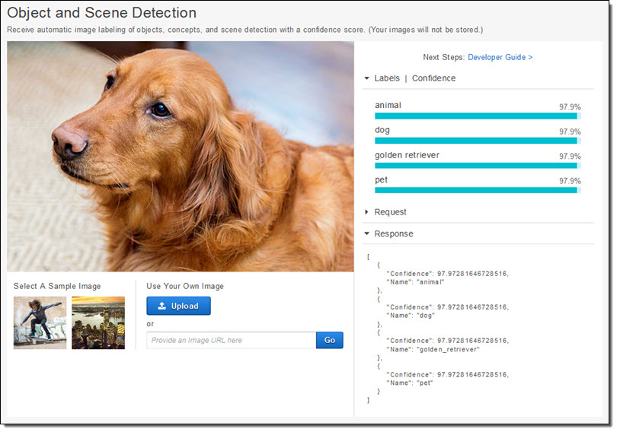
Uses of aws Rekognition
Searchable Image Library.
Face-Based User Verification
Sentiment Analysis.
Facial Recognition
Image Moderation.
Resource:Google

Slide 5
Objective
With Amazon Rekognition, you can identify objects, people, text, scenes, and activities in images and videos, as well as detect any inappropriate content.
Our main aim in this case study is to detect the Text and comparing the faces by taking source image and Target image with the use of storage bucket , lambda function and aws recognition API.
I have divided my case study into two parts: Text & Face
In the first part, I am going to detect the text in the uploaded image and
In the second part ,I am going to compare the faces by taking two images.

Slide 6

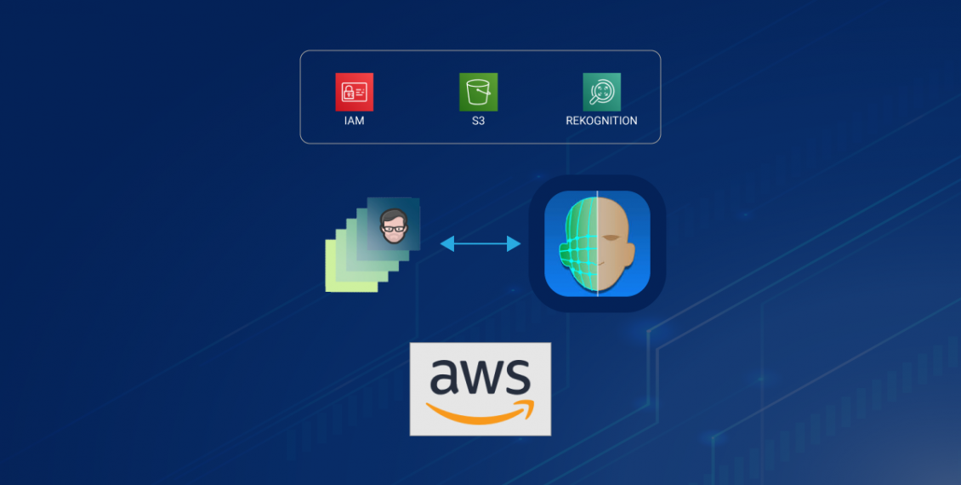

Slide 7
Architecture
Creating a storage bucket S3 and granting public access to the bucket and then we have to upload the images in the S3 bucket.
Creating Lambda function with python runtime.
Setting up our security rules using IAM.
Attaching policies to the roles.(Amazon Rekognition Full Access)
Testing the Lambda function.

Slide 8

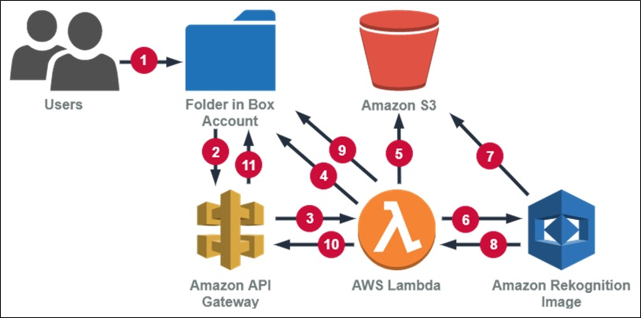
Cloud features used in the case study

Slide 9
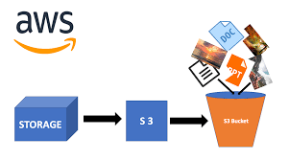
S3 storage Bucket
An Amazon S3 bucket is a public cloud storage resource available in Amazon Web Services' (AWS) Simple Storage Service (S3), an object storage offering. Amazon S3 buckets, which are similar to file folders, store objects, which consist of data and its descriptive metadata.

Slide 10
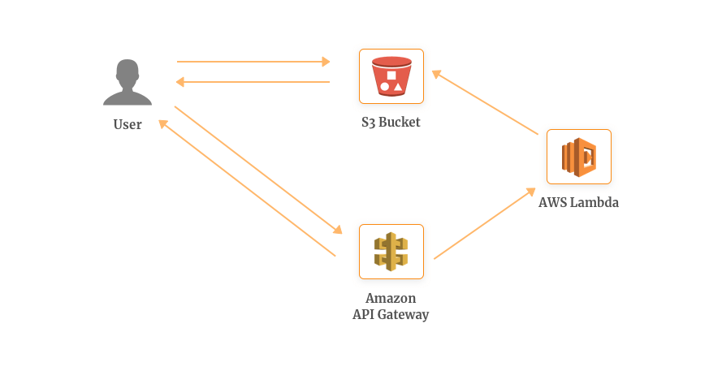
Lambda function
AWS Lambda lets you run code without provisioning or managing servers. A lambda function is a small anonymous function. A lambda function can take any number of arguments, but can only have one expression.

Slide 11
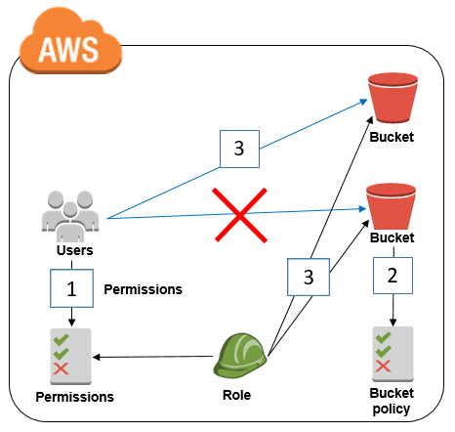
IAM roles in aws
An IAM role is an AWS Identity and Access Management (IAM) entity with permissions to make AWS service requests. IAM roles cannot make direct requests to AWS services; they are meant to be assumed by authorized entities, such as IAM users, applications, or AWS services such as EC2.

Slide 12
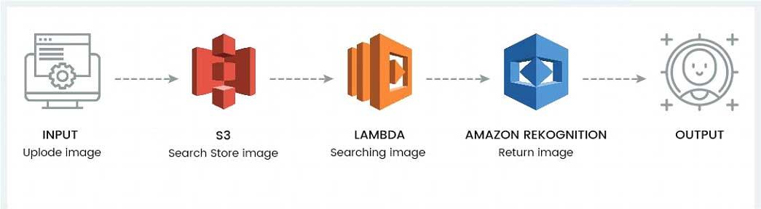
Amazon Rekognition
Amazon Rekognition is a service that makes it easy to add powerful visual analysis to your applications. Rekognition Image is an image recognition service that detects objects, scenes, and faces; extracts text; recognizes celebrities; and identifies inappropriate content in images.

Slide 13
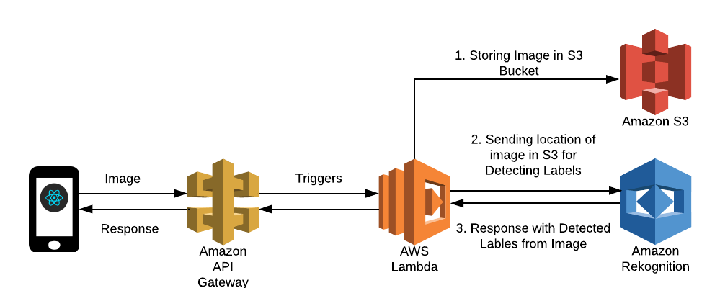
Architecture diagram
Reference:Google

Slide 14
References
AWS Rekognition Developer Guide
Ample Material- Cloud computing & services

